Slide 1

IOT Based Smart Irrigation System using Cisco Packet Tracer
SRM INSTITUTE OF SCIENCE AND TECHNOLOGY
DEPARTMENT OF COMPUTATIONAL INTELLIGENCE
Student 1- Bhavishya Dhiman (RA1911033010056)
Student 2 – Tanmay Purwar(RA1911033010072)
Student 3 – Neelabh Saxena (RA1911033010093)
Guide Name and Designation:
Dr. A. Revathi - Assistant Prof

Slide 2
Table of Contents
Abstract
Introduction
Methodology
Home Gateway
Automatic Sprinkler System
Scope of the project
References

Slide 3
Abstract
Irrigation system is a method used to supply water to the plants as uniformly as possible. In the Internet of Things (IoT), technology devices or sensors are connected via the internet and can be remotely operated and monitored by the user. In this project, the implementation is done by performing the simulation for a smart irrigation system with the help of the Cisco packet tracer simulation software with new version Cisco Packet Tracer 7.3.0 (64-bit). This technology can be implemented for developing a smart irrigation system, which consists of devices like a lawn sprinkler, temperature monitor, Humidity monitor, etc., to automate the watering system and remotely monitor the environmental conditions for better growth of the plants.

Slide 4
Abstract
All the devices are connected to the home gateway and can be remotely operated and monitored using a Tablet/PC/Smartphone. Simulation results show that the smart devices such as a sprinkler system and other essential devices for monitoring environmental conditions are connected to the home portal and can be successfully monitored, which helps the farmers/homeowners to grow and maintain plants with ease.

Slide 5
Introduction
The term IoT means ‘Internet of Things’, which was coined by Kevin Ashton in 1999. It is a budding technology that plays a major role in today’s life to interconnect devices and the internet in a network, which in turn enables them to send and receive data
There are many problems faced by the farmers or the homeowners having a lawn space for gardening and the maintenance of the plants due to the changing environmental conditions. IoT technology can help the farmers/homeowners to maintain a proper irrigation system that can be automated and remotely operated from any part of the world.
In today’s busy world, if the homeowners are not present in the house to take care of the plants, this technology can help them to easily monitor the devices and thus helps to overcome the disadvantage of manual monitoring.
In this work, Smart Irrigation system consists of smart devices that automate the irrigation system that allows the homeowners to automate the lawn sprinkler/ watering system according to the level of the water shown by the water level monitor, which results in turning the water drain on or off accordingly. Smart Irrigation system provides various automating activities such as controlling the humidity levels of the plants. The humidity sensor monitors the level and turns the humidifier on or off after it reaches a certain level set according to the requirements of the owner.
The simulation results show that smart devices are connected to the home gateway and can be remotely operated, monitored, and automated according to the requirements
Cisco Packet Tracer is a visual simulation tool developed by Cisco that gives users the chance to make network topologies and imitates modern computer networks. It allows you to simulate routers and switches by using a simulated command-line interface.

Slide 6
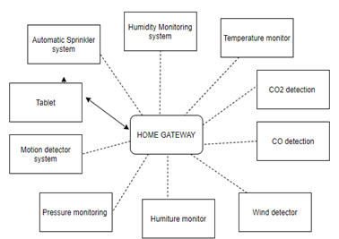
Methodology
The design of the Smart Irrigation system has been done by using the Cisco Packet Tracer simulation software. Cisco Packet Tracer is an innovative and powerful network simulator that can be used for building a network with routers, switches, wireless, and much more. It allows to experiment with network behavior, device configuration, and building models. Smart Irrigation system design includes a tablet and home gateway used to connect to various devices like temperature monitor, lawn sprinkler, water level monitor, and other sensors. Home gateway is used to connect all the smart devices, and Tablet is used to communicate with the smart devices.
Figure 1. Block Diagram of Smart Irrigation System

Slide 7
Home Gateway
To connect to the network, either a home gateway is required or a registration server. After connecting to the PC or a tablet to the home gateway, the devices can be turned on and off using the features of the home gateway.
The home gateway provides internet access and wireless connectivity to the network and acts as a local connection to the IoT smart devices. The device has an internet port, four LAN ports, and multiple antennae. After connecting the home gateway to the existing network, the network settings are need to be set that are configurable by clicking on the config tab. The IP addressing information can be seen under the internet settings tab after connecting the device to the existing network. The wireless settings need to be configured by entering the home gateway SSID and selecting WPA2-PSK PSK passphrase and a password for authentication and validation of the wireless network. The next step is to connect the IoT smart devices to the home gateway.
To configure and register the smart IoT devices with a home gateway, the following steps should be done. Select the device, and in the I/O config, select wireless adapter from the network adapter dropdown list. Select Config to verify that the device has established a wireless connection to the correct SSID. Then, Select Config/Settings and select the home gateway as the IoT server registration device.

Slide 8
Automatic Sprinkler System
The automatic sprinkler system consists of a lawn sprinkler, water level monitor, water drain, and a light indicator
The water level monitor is used for water level detection. The user can set the parameters for the water level monitor according to requirements.
If the level of the water goes up to the minimum required level, it turns the lawn sprinkler off and turns the water drain on automatically
Similarly, it turns the Sprinkler on if the level of water is less than the required level
This feature of the Automatic lawn sprinkler system eliminates the disadvantages of manual monitoring of the irrigation system

Slide 9
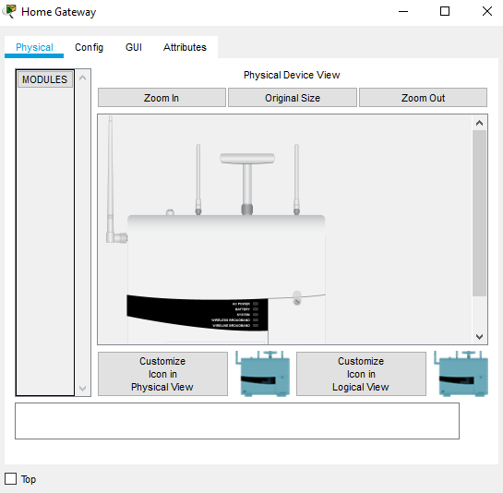
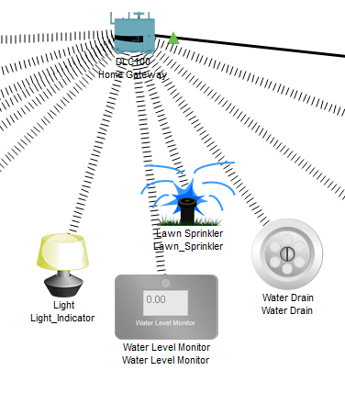
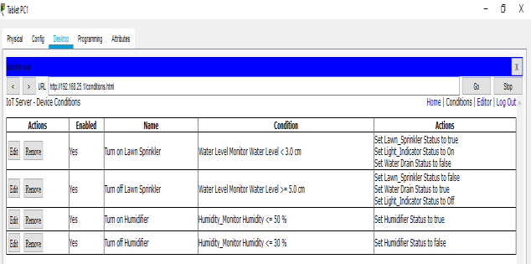
Smart Irrigation System

Slide 10
Conclusion and Future Scope
A smart irrigation system is implemented using the Cisco packet tracer. A home gateway to register the devices and control them using a tablet. All the IoT devices connected to the home gateway can be monitored manually as well as remotely by the user
The results prove that there is an opportunity of applying this model in real life. The implementation of the automatic irrigation system can be used to reduce the use of water.
The system can be manually monitored, it can increase the energy efficiency and savings

Slide 11
Conclusion and Future Scope
It also makes it convenient for the user to access all the devices through the smartphone. In the field of IoT, ensuring security should be a priority. Since the IoT devices are interconnected to each other, the network should be secured
In this system, an authentication gateway is designed that requires password to check authenticity of the home user for security purpose
purpose. To extend this system to be more robust and efficient in the future, modifications can be made to make the system more secure. If abnormalities in the system are detected, the system should send an SMS or an Email to alert the user.

Slide 12
References
Egemen Hopalı, Özalp Vayvay, “Internet of Things (IoT) and its Challenges for Usability in Developing Countries” International Journal of Innovation Engineering and Science Research, Vol. 2 , Issue. 1 January 2018
Ghaliya Alfarsi, Ragad M Tawafak, Abir Alsidiri, Jasiya Jabbar, Sohail Iqbal Malik, Maryam Alsinani, “Using Cisco Packet Tracer to simulate Smart Home”, Vol. 8 , Issue 12, December 2019
Sahana B, D. K. Sravani , Dhanyashree R Prasad “Smart Green House Monitoring based on IOT”, IJERT, Vol.8, Issue.14, August 2020
Sneha Angal, “Raspberry pi and Arduino Based Automated Irrigation System”, International Journal of Science and Research (IJSR), Vol. 5 Issue. 7, July 2016.
Isa Shemsi, “Implementing smart home using cisco packet tracer”, IJERT, Vol.4, Issue.7, January 2018

